Slide 1
District-Wise Data Analysis
Analyzing Trends from 2013 to 2022

Slide 2
Introduction
This analysis explores district-wise data from 2013 to 2022.
The dataset provides insights into trends across multiple districts, helping in understanding patterns over the years.
By analyzing these trends, we can identify key variations and make data-driven decisions.

Slide 3
Overview of the Dataset
The dataset contains values for different districts across multiple years.
Key aspects include:
District names
Yearly recorded values from 2013 to 2022
Trend analysis for identifying patterns over time
Further analysis will help in understanding variations and correlations within the data.

Slide 4
Data Cleaning
Before analysis, data cleaning was performed to ensure consistency:
Removed unnecessary spaces from column names
Converted years to proper format
Checked for missing values and handled them appropriately
Ensured data types were correctly formatted for numerical analysis

Slide 5
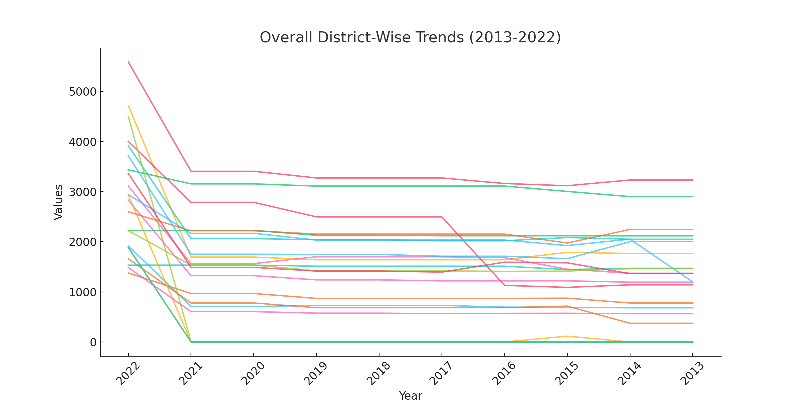
Overall District-Wise Trends (2013-2022)

Slide 6
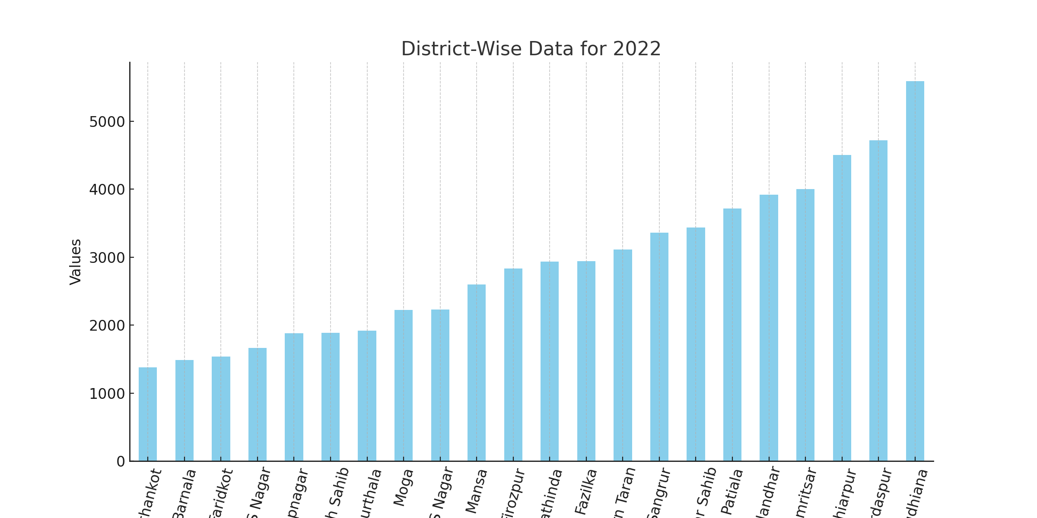
District-Wise Data for 2022

Slide 7
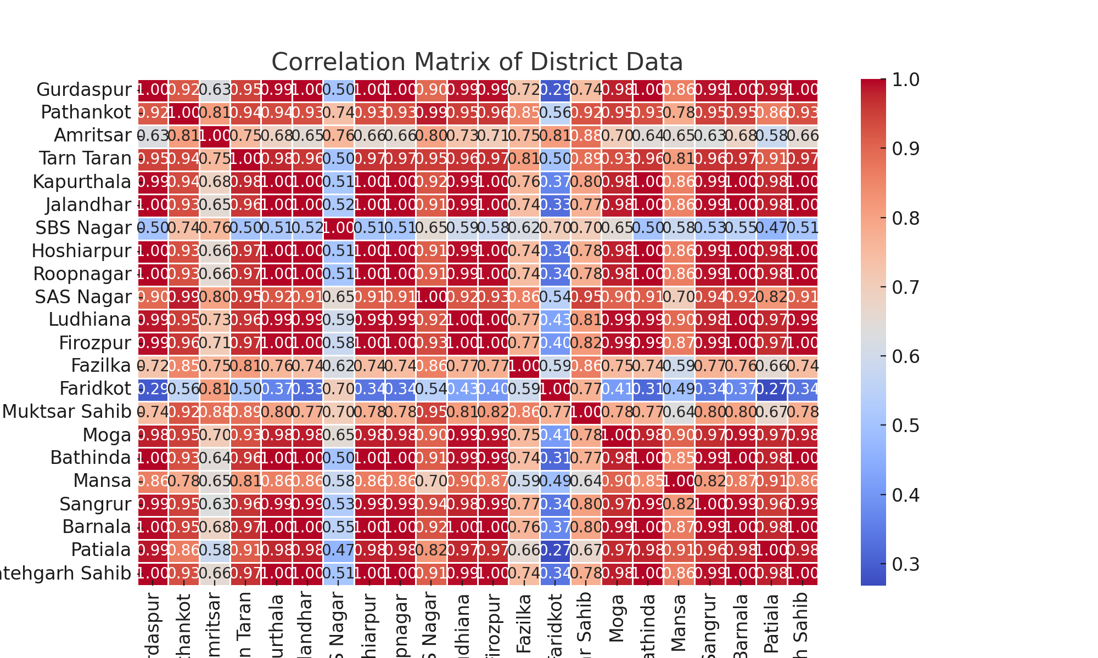
Correlation Matrix of District Data

Slide 8
Final Observations
Key findings from the dataset analysis:
Certain districts show a significant increase in values over the years.
The data for 2022 highlights variations across different regions.
Correlation analysis helps in understanding relationships between districts.
Further insights can be derived by exploring trends at a deeper level.

Slide 9
Column Descriptions
The dataset consists of the following columns:
- **Name/Year**: The district name or the year for the recorded values.
- **2013-2022**: Recorded values for each year from 2013 to 2022.
Each column represents the recorded metric for that district in the given year, allowing for trend analysis over time.

Slide 10
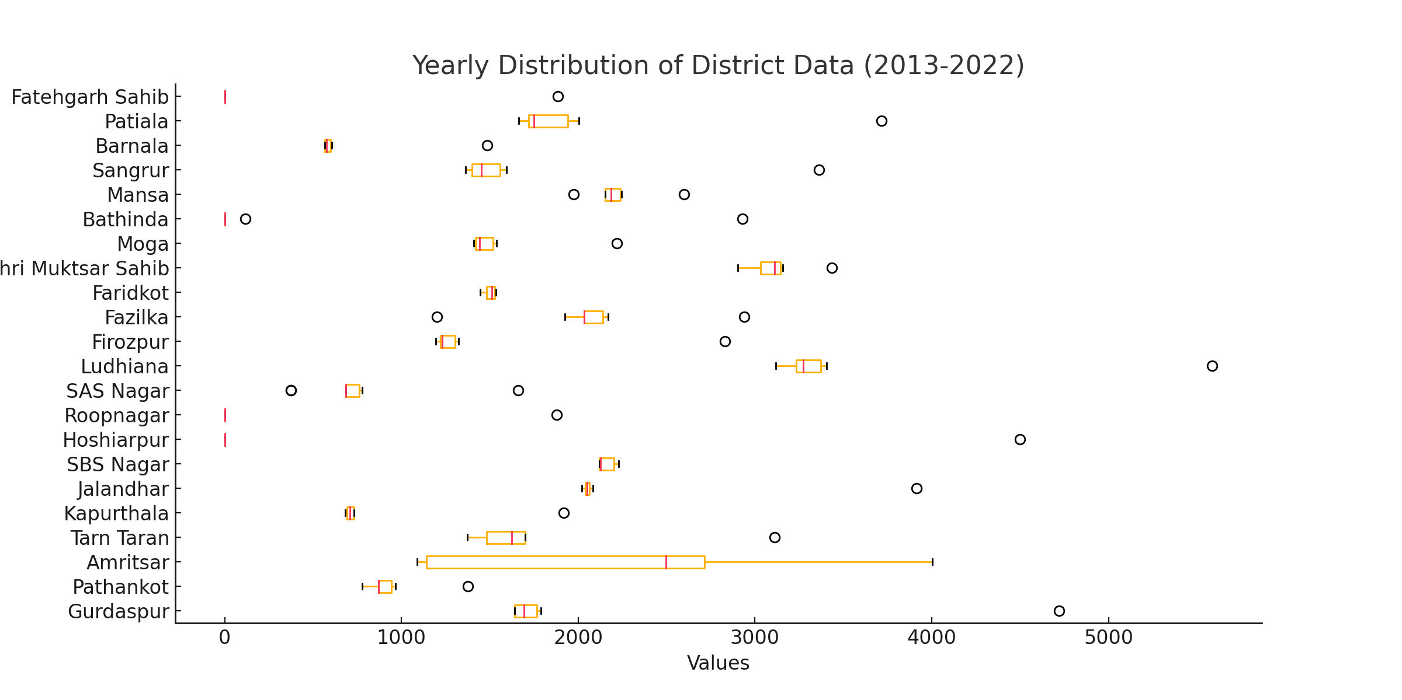
Yearly Distribution of District Data (Boxplot)

Slide 11
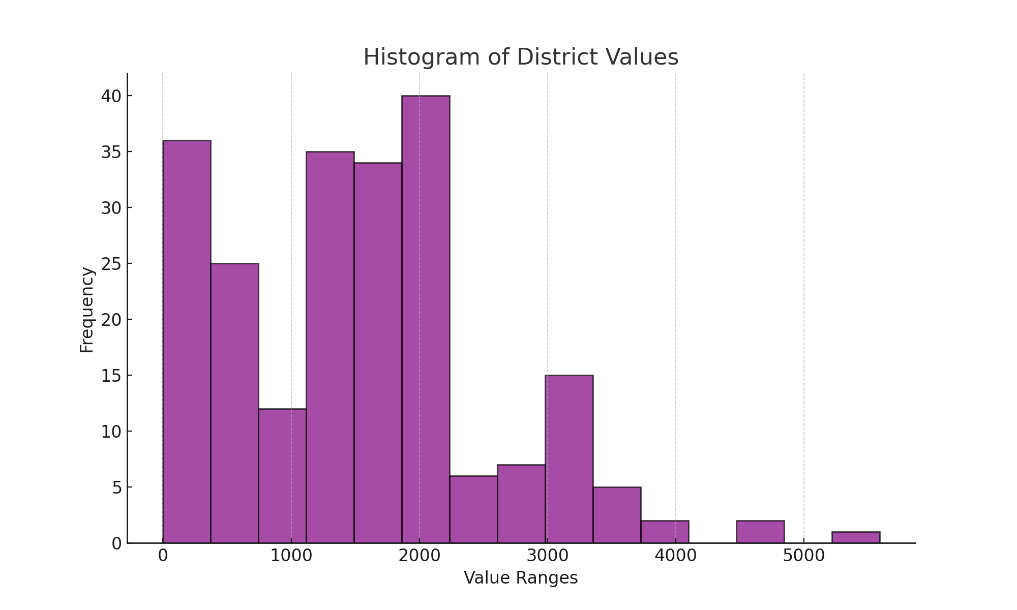
Histogram of District Values

Slide 12
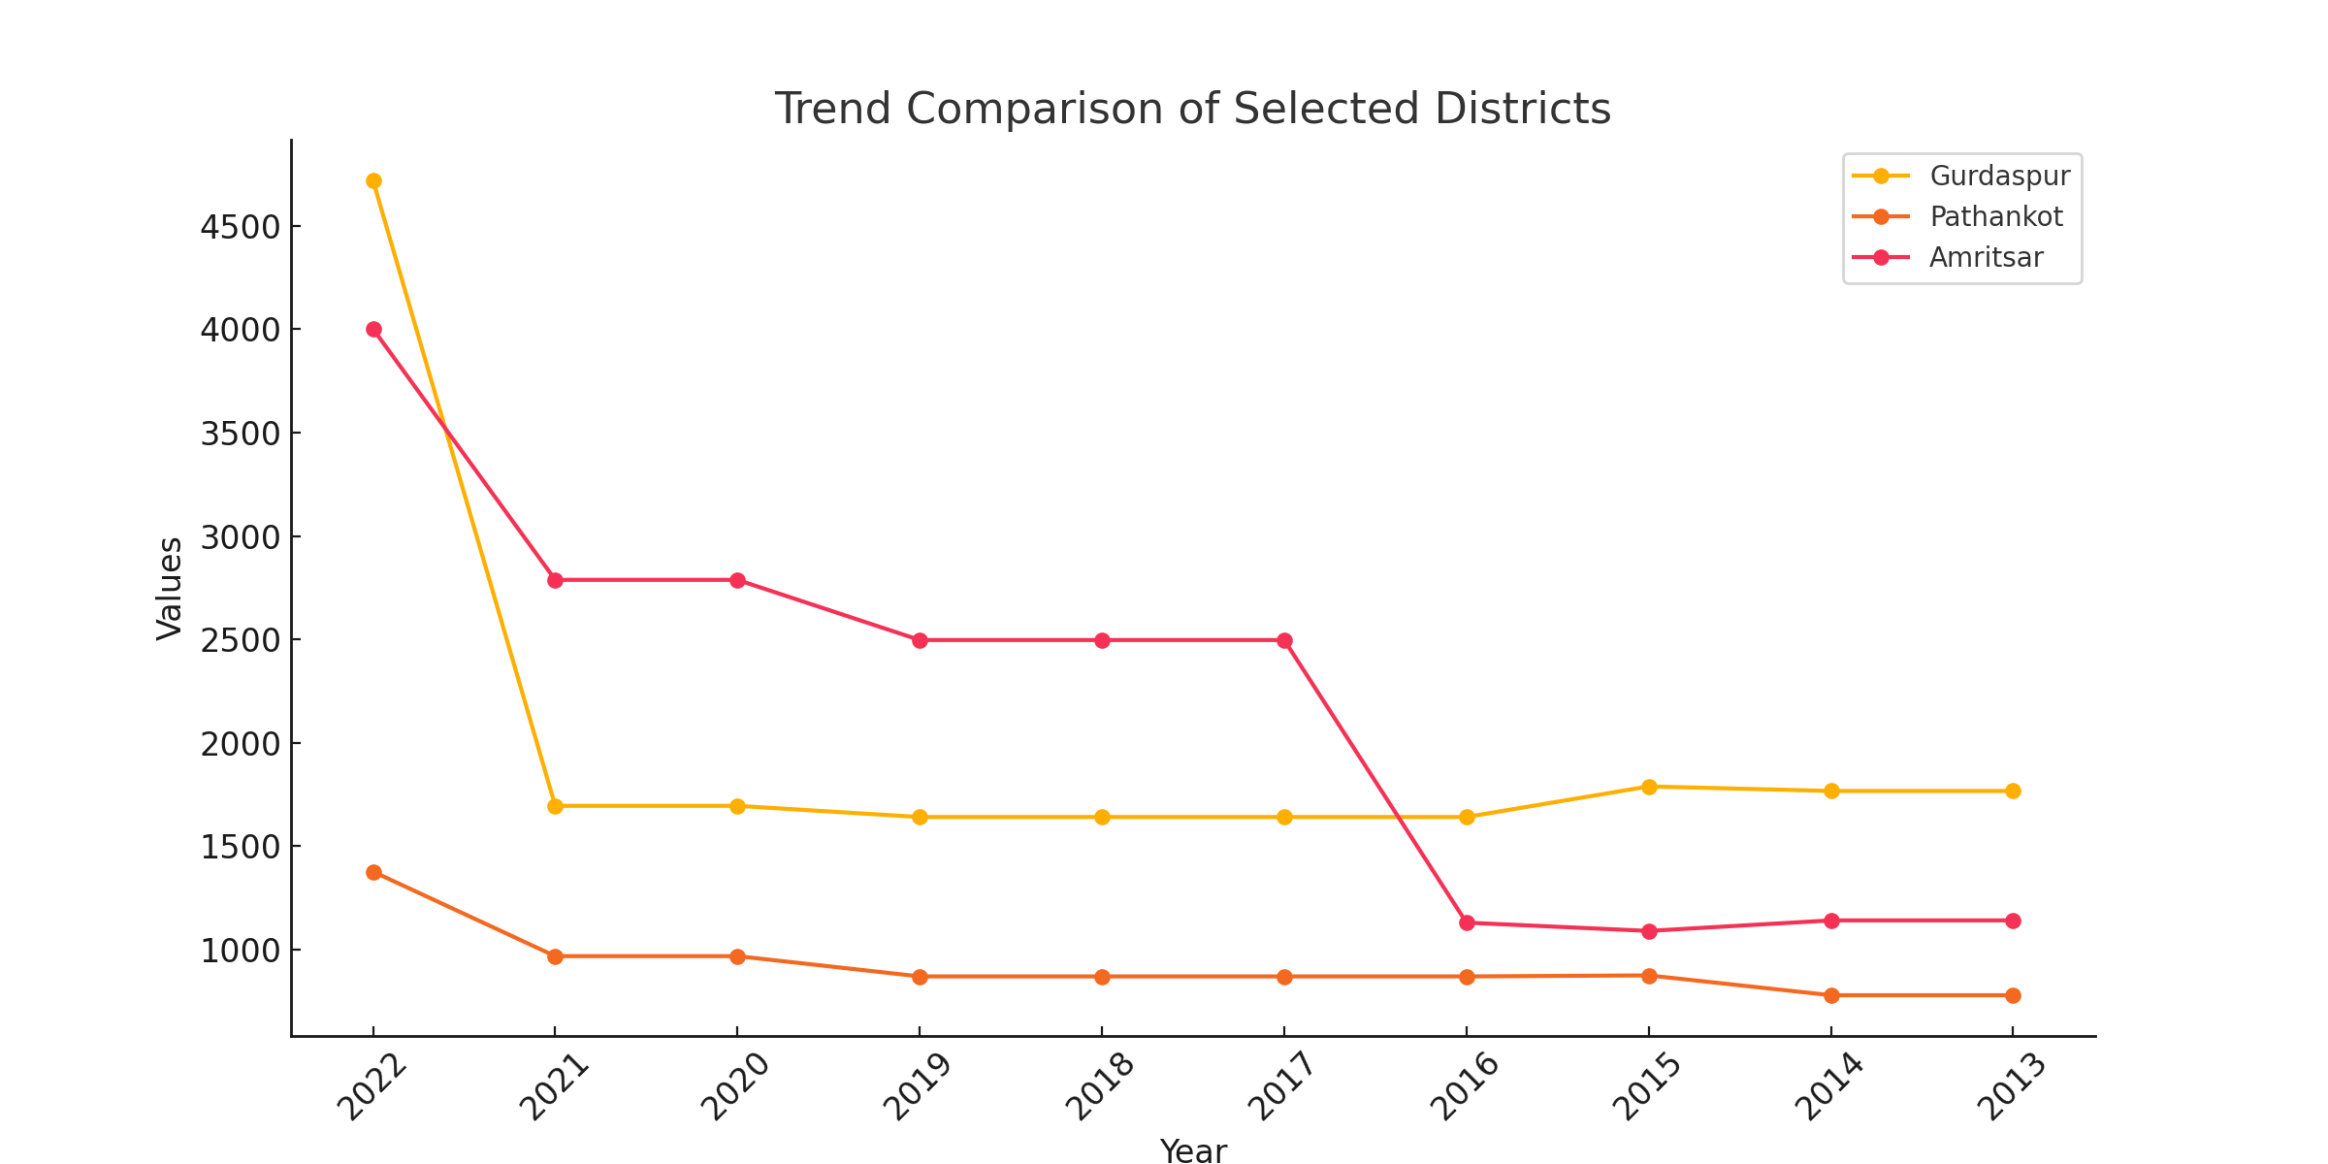
Trend Comparison of Selected Districts

Slide 13
Summary and Key Takeaways
From our analysis, we observe:
Certain districts have consistently higher values over the years.
The overall trends show fluctuations with some districts experiencing significant increases.
The correlation analysis highlights relationships between different districts.
The histogram and boxplot reveal the distribution and spread of the data.
This analysis provides a solid foundation for further exploration and decision-making.

